Slide 1
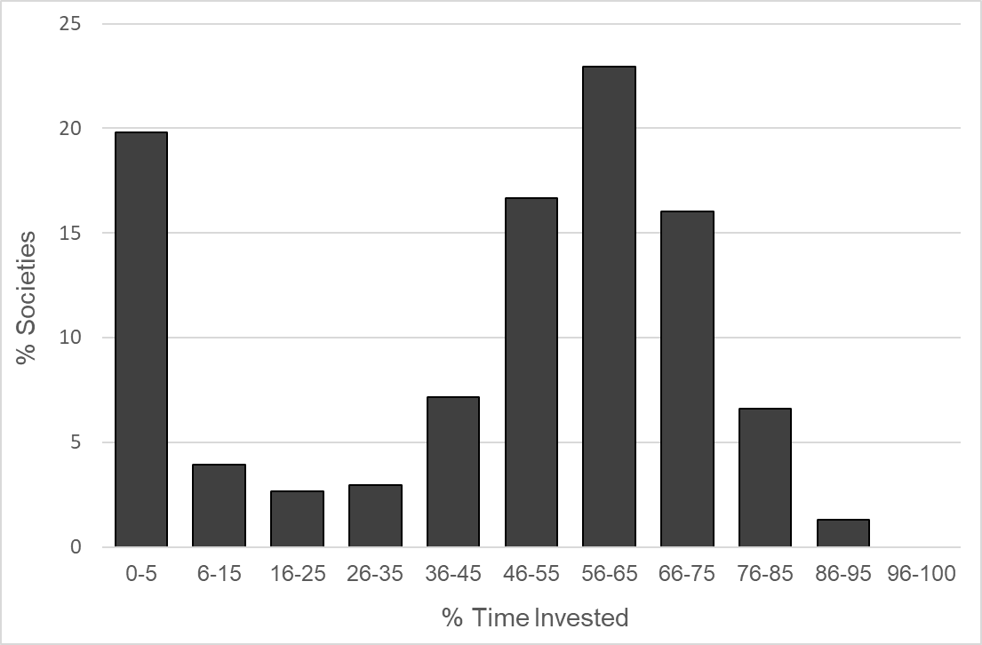
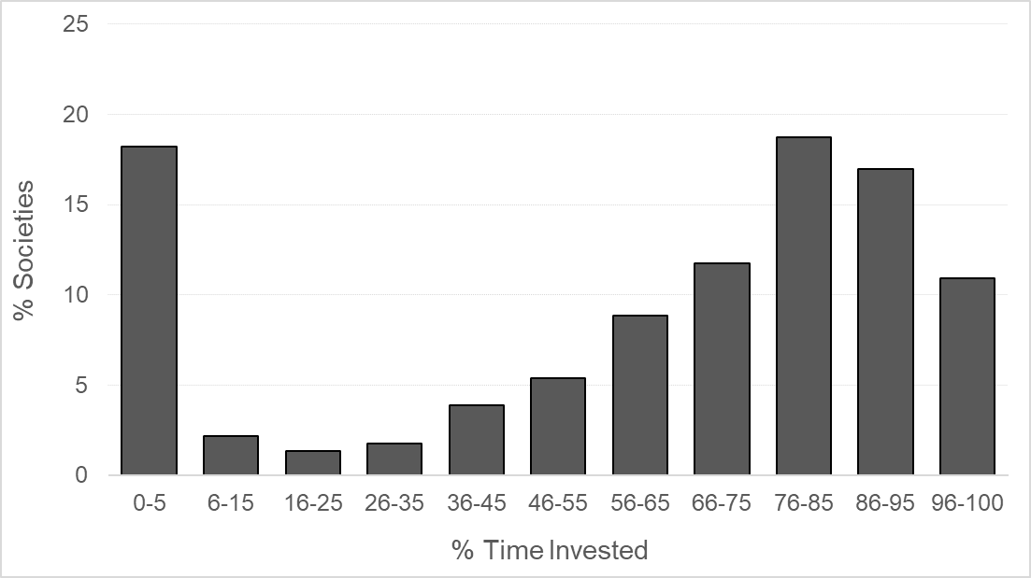
Figure 1
a) Plant cultivation
b) Farming (plant cultivation and animal husbandry)

Slide 2
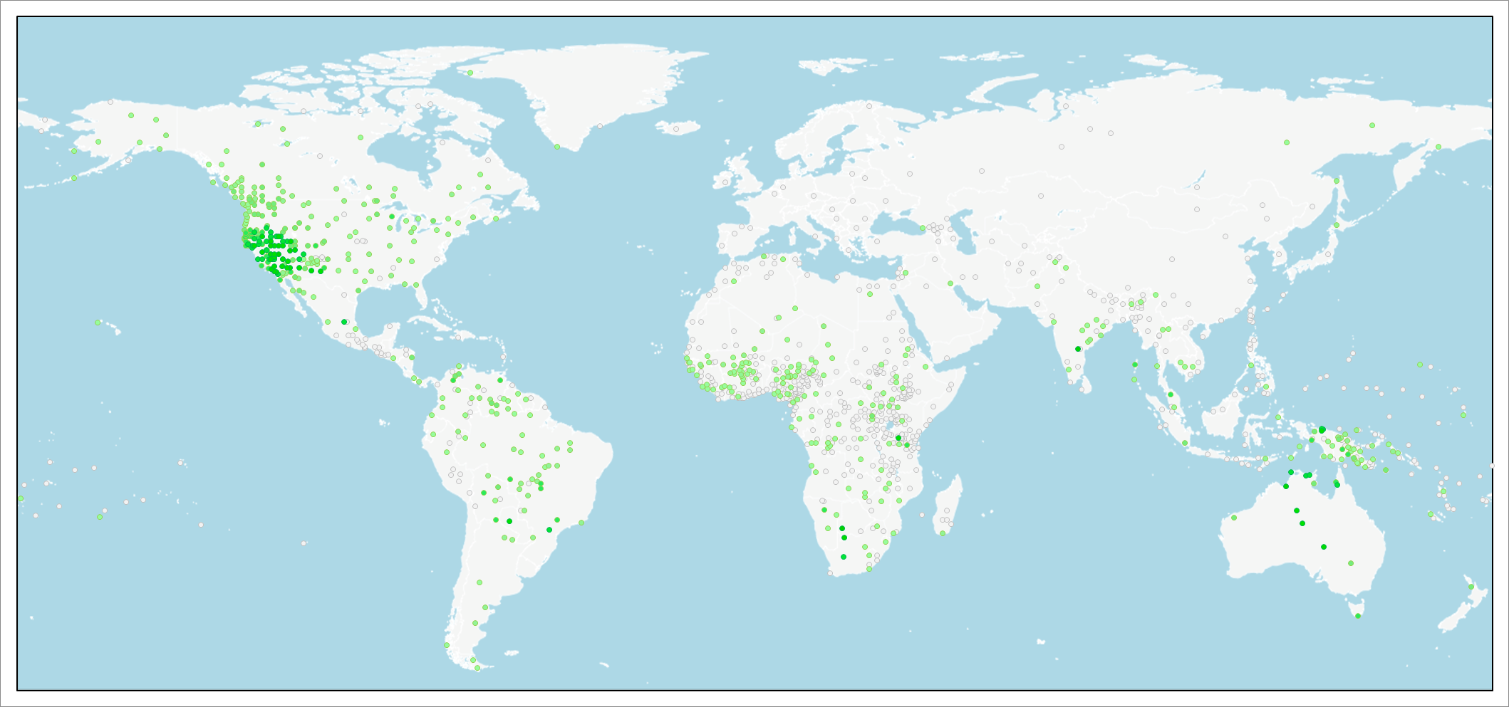
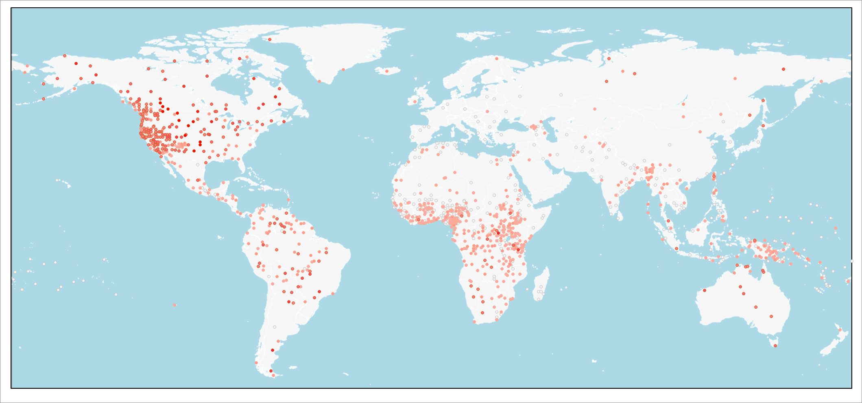
Figure 2
a) Gathering
b) Hunting

Slide 3
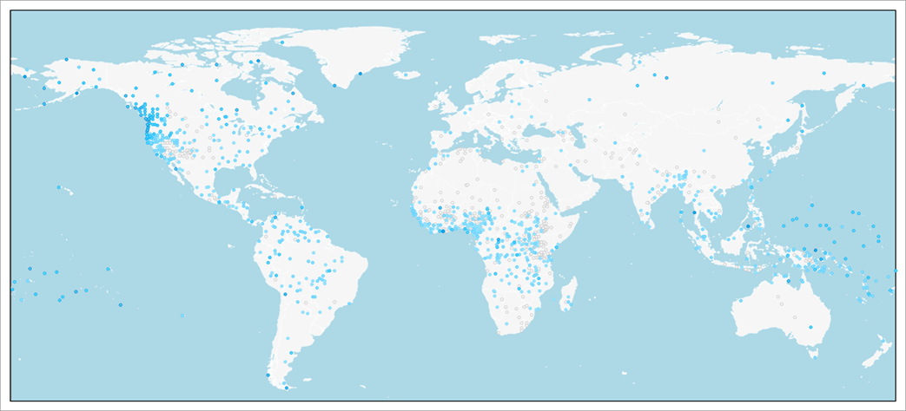
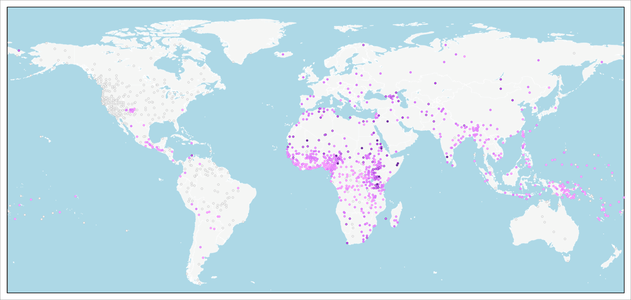
Figure 2 (continued)
c) Fishing
d) Animal husbandry

Slide 4
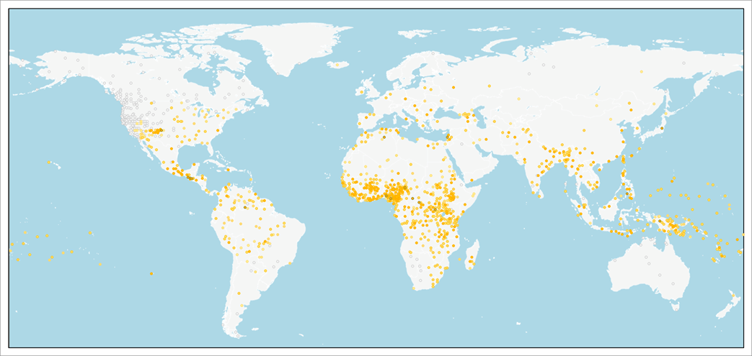
Figure 2 (continued)
e) Plant cultivation
Key

Slide 5
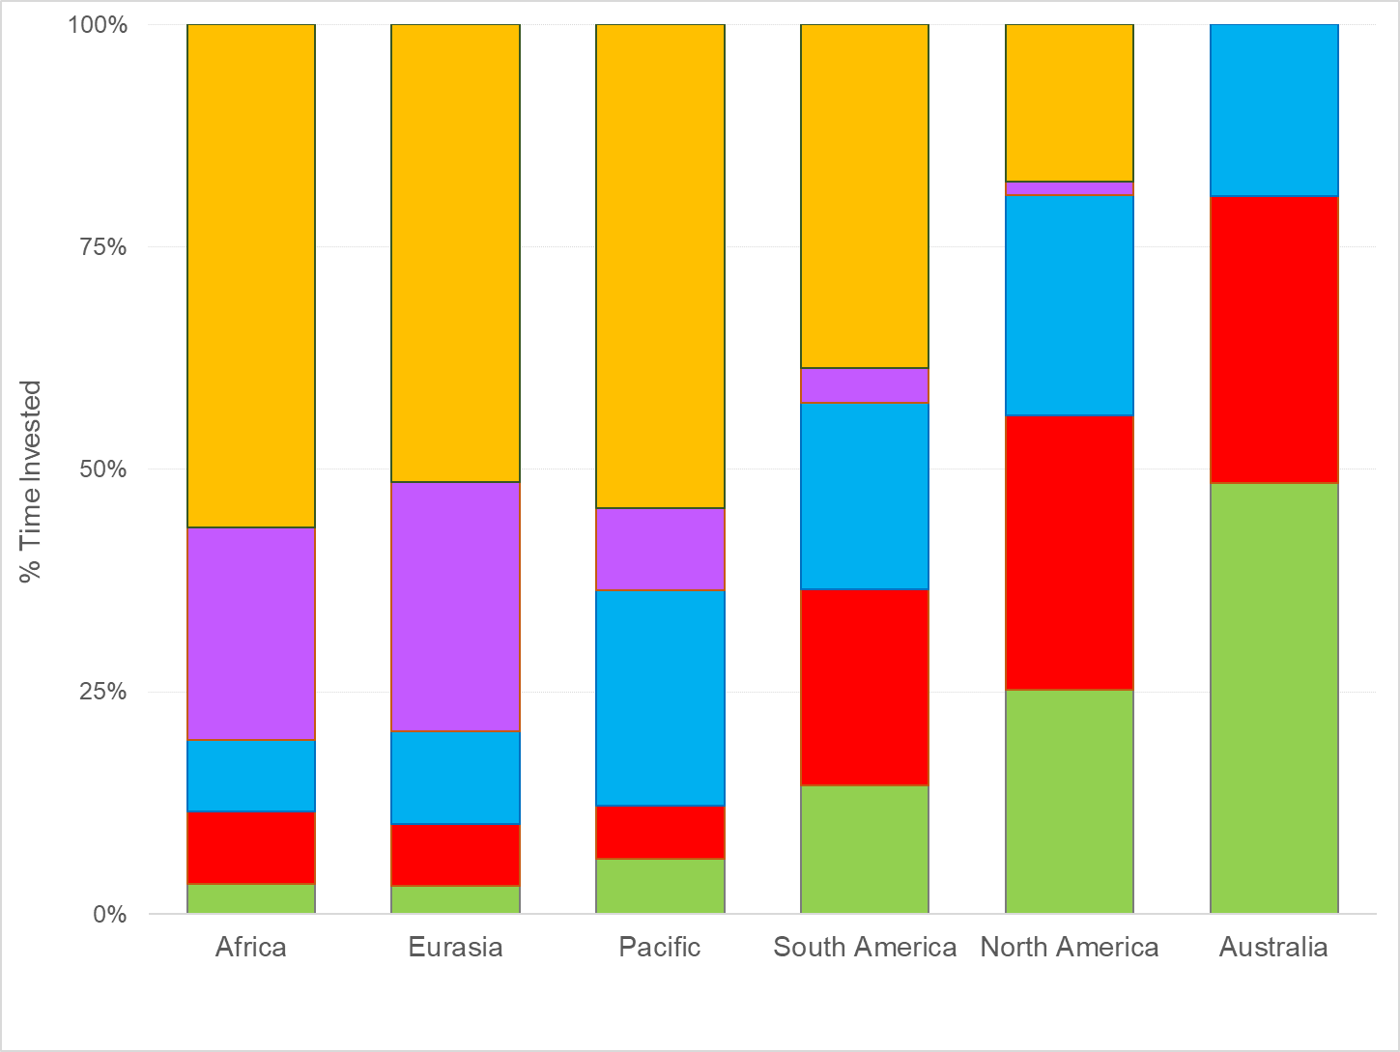
Figure 3

Slide 6
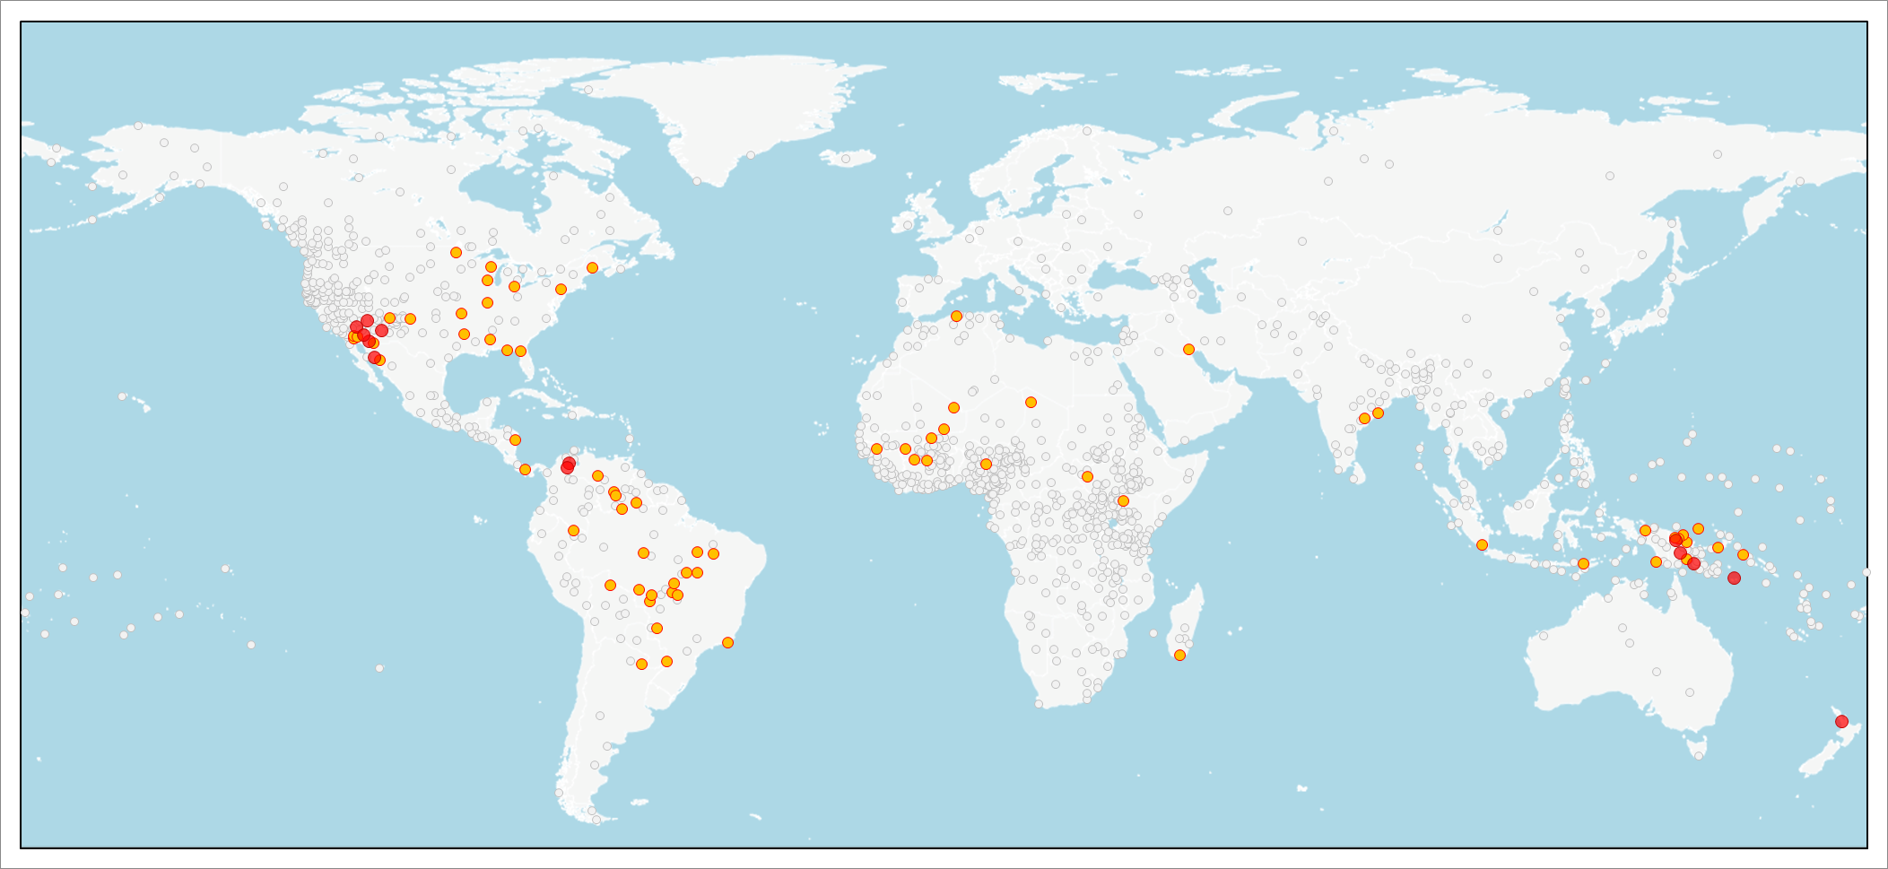
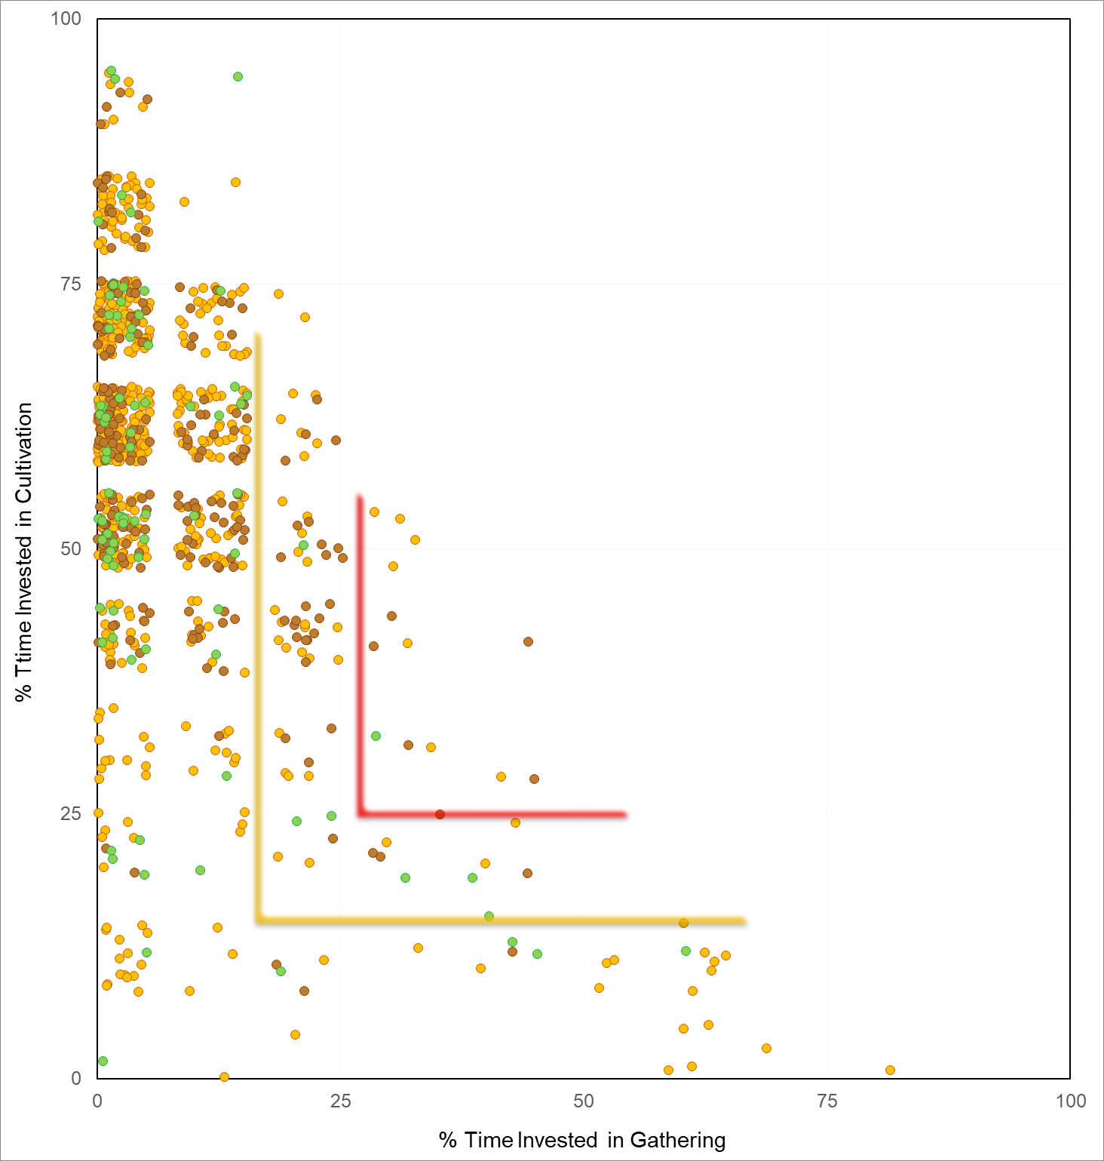
Figure 4
a) Map of middle ground societies
b) Graph of middle ground societies

Slide 7
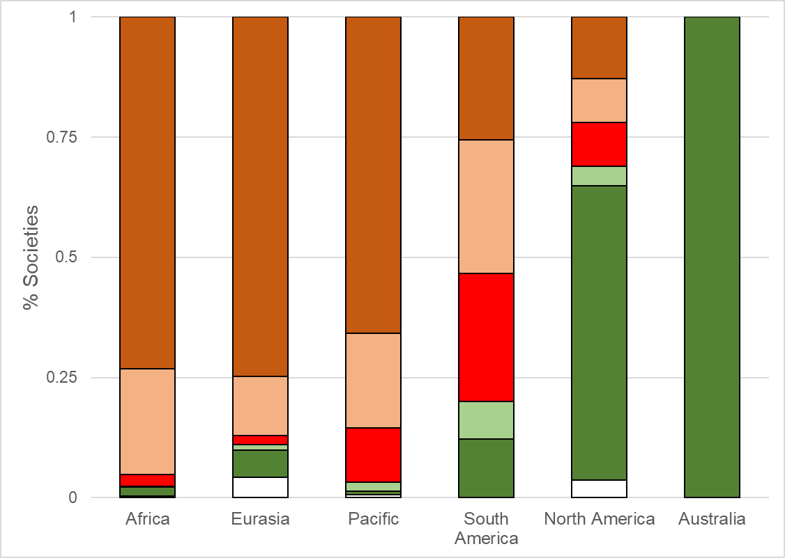
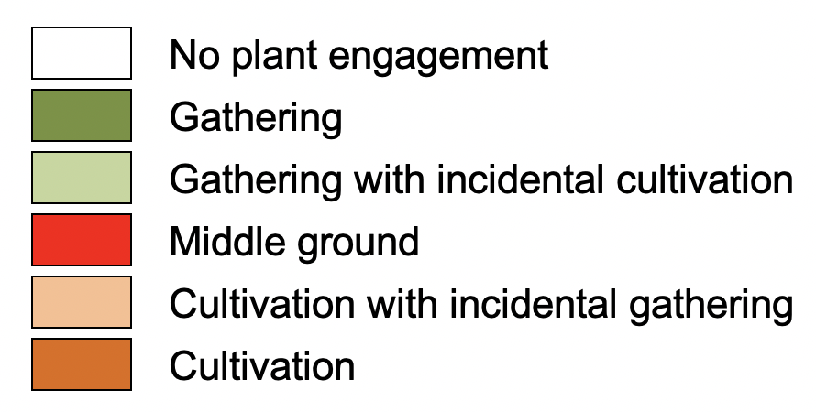
Figure 5

Slide 8
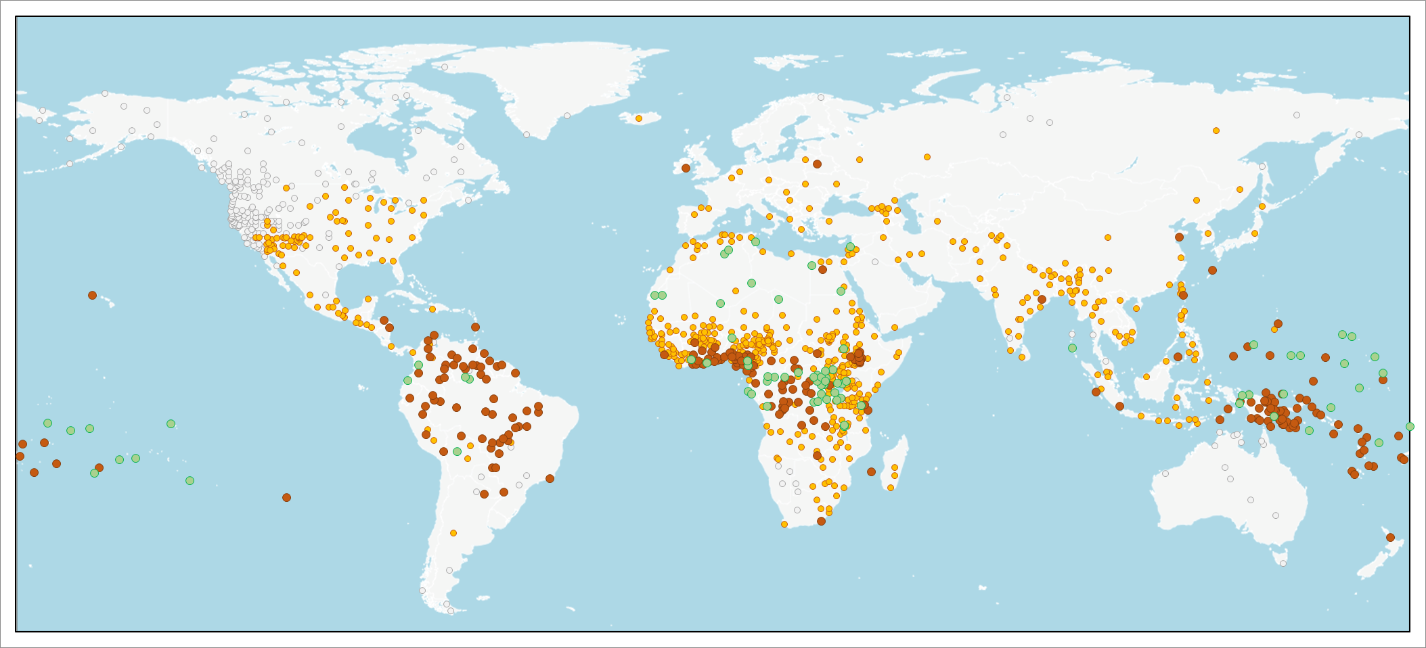
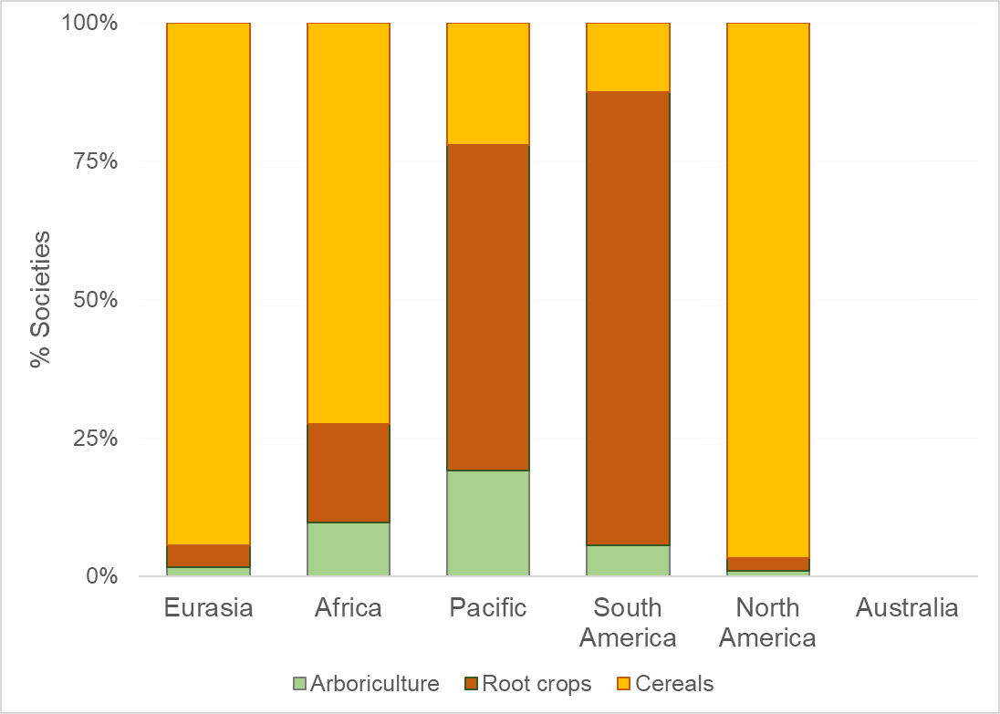
Figure 6
a) Map of dominant crop types
b) Graph of dominant crop types by continent

Slide 9
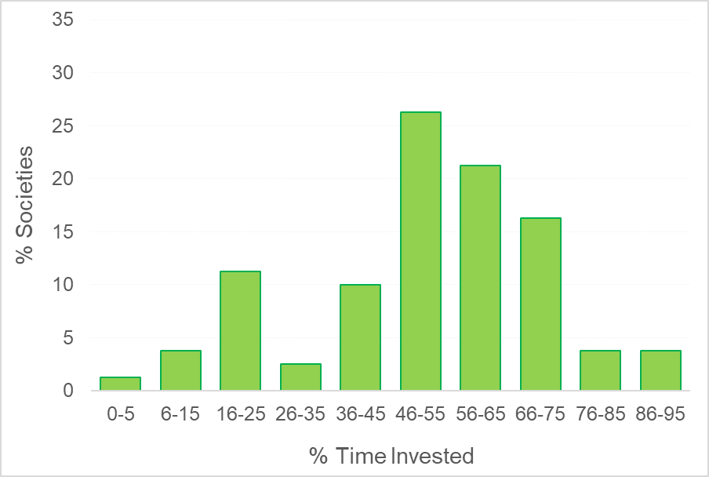
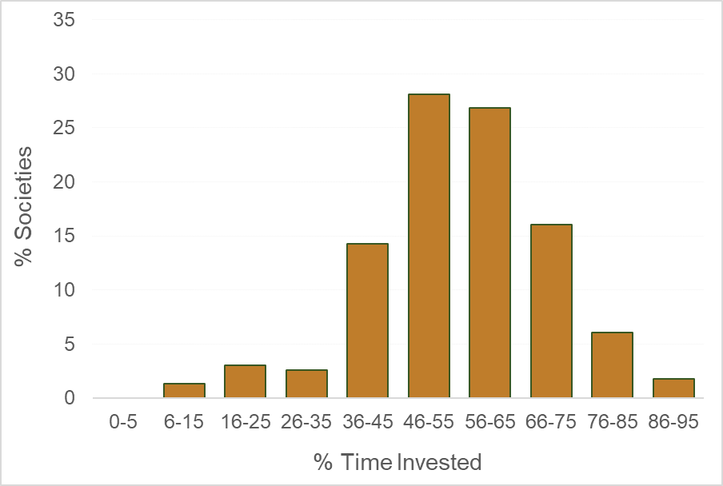
Figure 7
a) Arboriculture (n = 80)
b) Root crops (n = 231)

Slide 10
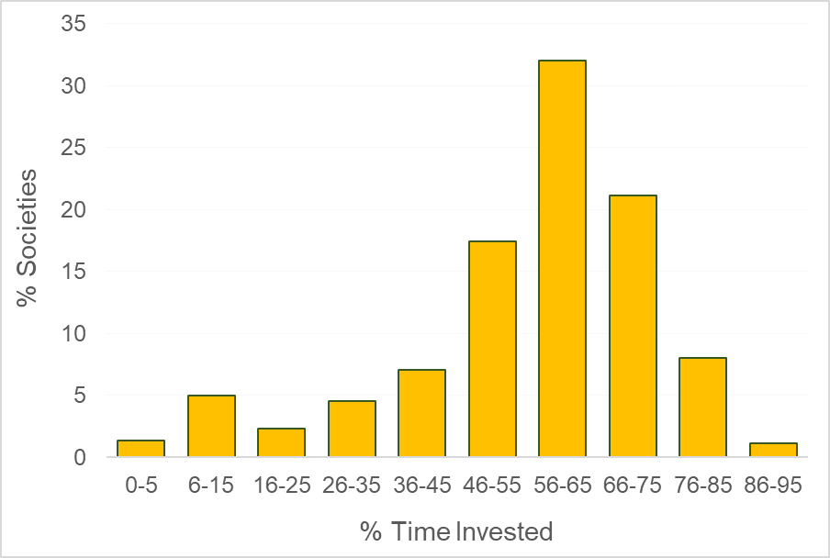
Figure 7 (continued)
c) Cereals (n = 597)

Slide 11
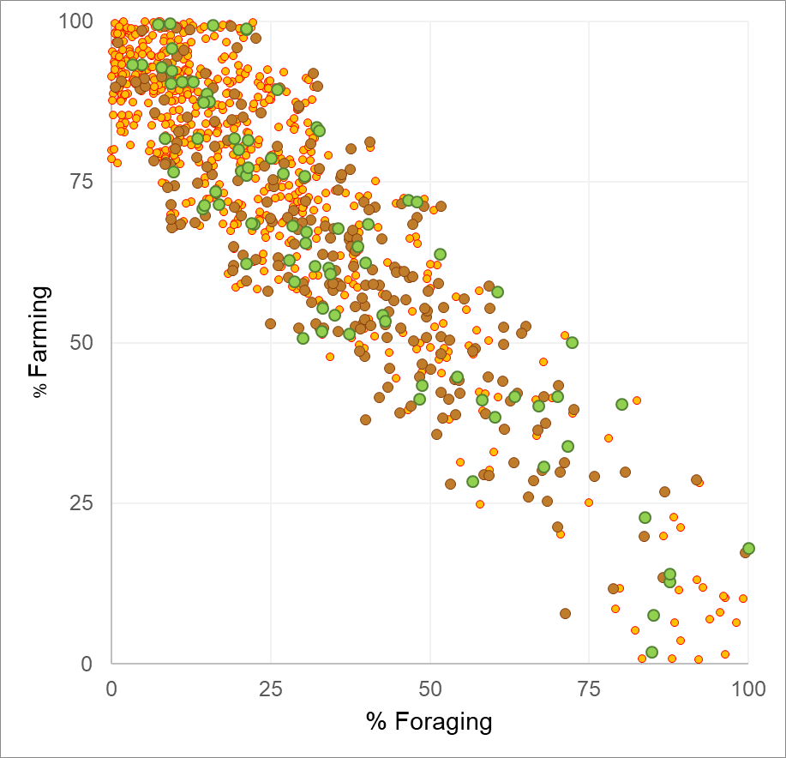
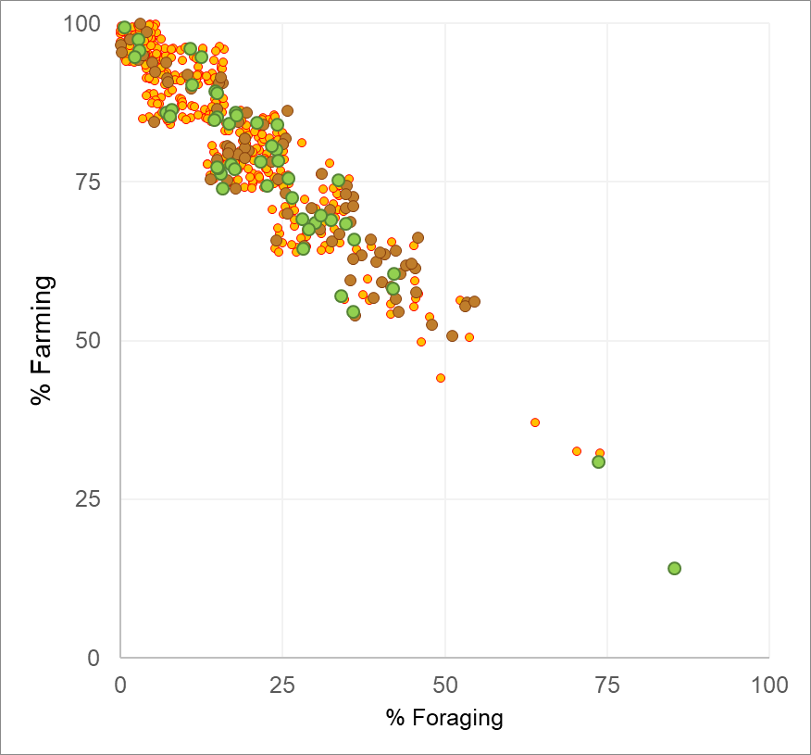
Figure 8 (continued)
a) World (n = 1242)
b) Africa (n = 480)

Slide 12
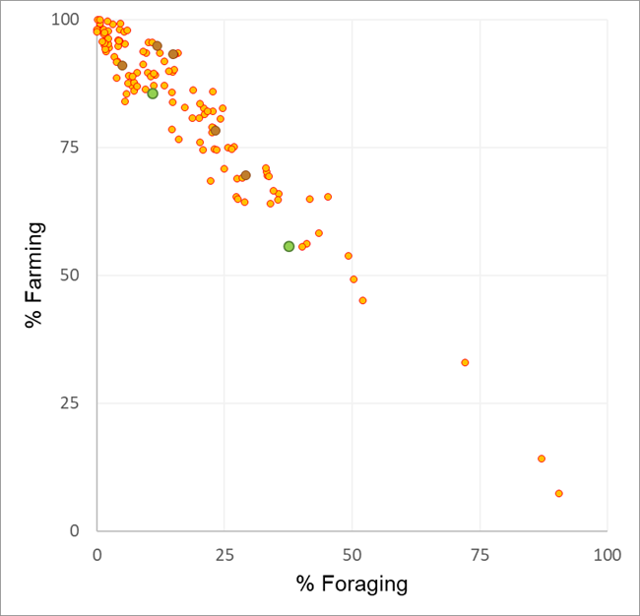
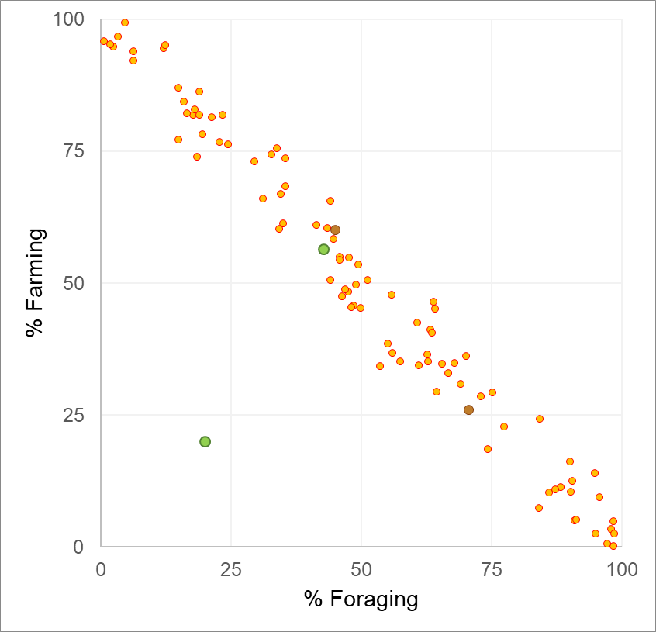
Figure 8 (continued)
c) Eurasia (n = 126)
d) North America (n = 87)

Slide 13
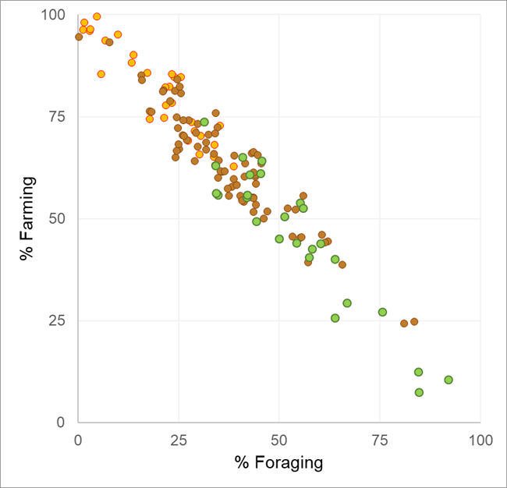
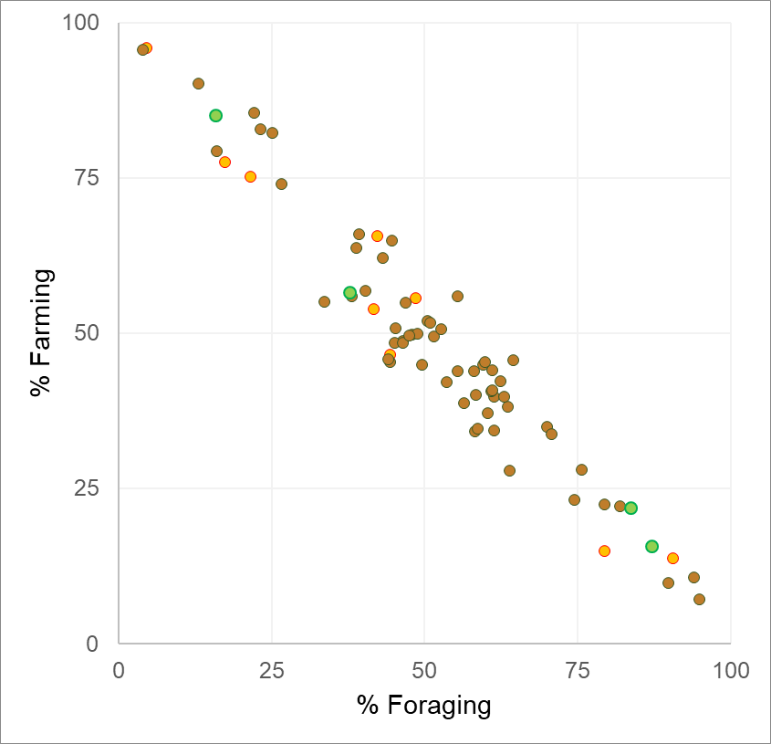
Figure 8 (continued)
e) Pacific (n = 135)
f) South America (n = 74)

